Slide 1
Java File I/O Chapter 12 Sections 12.10 to 12.11 Introduction to Java Programming – Comprehensive Version Y. Daniel Liang

Slide 2
The File Class
The File class contains the methods for obtaining the properties of a file/directory and for renaming and deleting a file/directory.
Data stored in a program are temporary; they are lost when the program terminates.
To permanently store the data created in a program, you need to save them in a file on a disk or other permanent storage device.
The File class enables us to obtain file/directory properties, to delete and rename files/directories, and to create new directories.

Slide 3
Absolute File Name vs. Relative File Name
Every file is placed in a directory in the file system.
Absolute File Name
An absolute file name (or full name) contains a file name with its complete path and drive letter.
For example, c:\book\Welcome.java is the absolute file name for the file Welcome.java on the Windows operating system.
Here c:\book is referred to as the directory path for the file.
Absolute file names are machine dependent.
On the UNIX/Linux platform, the absolute file name may be /home/liang/book/Welcome.java, where /home/liang/book is the directory path for the file Welcome.java.

Slide 4
Absolute File Name vs. Relative File Name
Relative File Name
A relative file name is in relation to the current working directory.
The complete directory path for a relative file name is omitted.
For example, Welcome.java is a relative file name. If the current working directory is c:\book, the absolute file name would be c:\book\Welcome.java.

Slide 5
The File Class
The File class is intended to provide an abstraction that deals with most of the machine-dependent complexities of files and path names in a machine-independent fashion.
The file name is a string. The File class is a wrapper class for the file name and its directory path.
For example, new File("c:\\book") creates a File object for the directory c:\book, and new File("c:\\book\\test.dat") creates a File object for the file c:\book\test.dat, both on Windows.
The directory separator for Windows is a backslash (\). The backslash is a special character in Java and should be written as \\ in a string literal (see Table 4.5)
You can use the File class’s isDirectory() method to check whether the object represents a directory, and the isFile() method to check whether the object represents a file.
The File class contains the methods for obtaining file and directory properties and for renaming and deleting files and directories, as shown in Figure 12.6.
However, the File class does not contain the methods for reading and writing file contents.

Slide 6
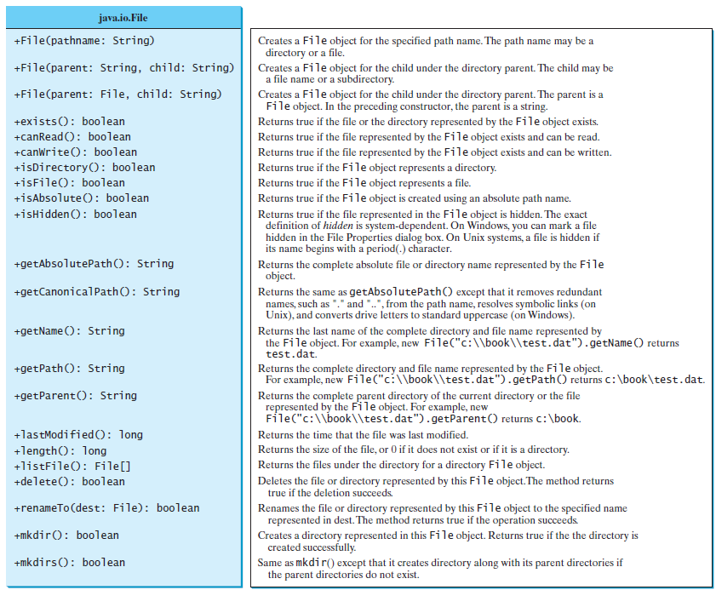
The File Class

Slide 7
The File Class
Caution: Do not use absolute file names in your program.
If you use a file name such as c:\\book\\Welcome.java, it will work on Windows but not on other platforms.
You should use a file name relative to the current directory.
For example, you may create a File object using new File("Welcome.java") for the file Welcome.java in the current directory.
You may create a File object using new File("image/us.gif") for the file us.gif under the image directory in the current directory.
The forward slash (/) is the Java directory separator, which is the same as on UNIX/Linux operating systems.
The statement new File("image/us.gif") works on Windows, UNIX/Linux, and any other platform.

Slide 8
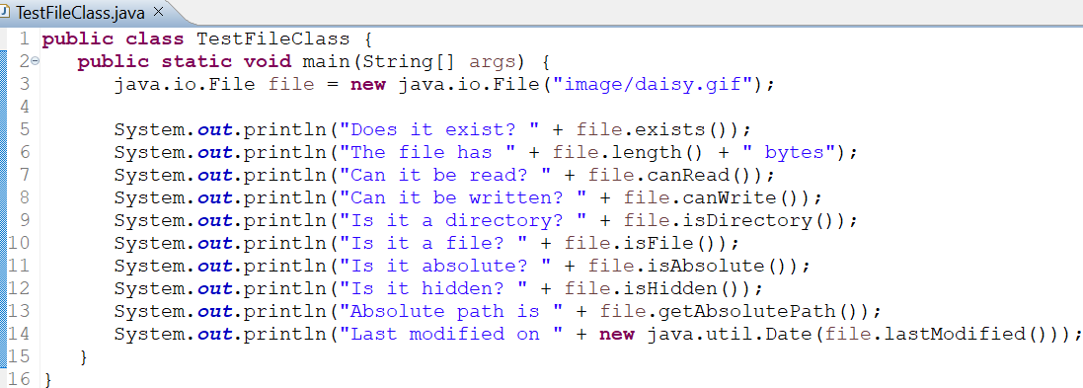
The File Class
The program creates a File object for the file us.gif.
This file is stored under the image directory in the current directory.
The lastModified() method returns the date and time when the file was last modified, measured in milliseconds since the beginning of UNIX time (00:00:00 GMT, January 1, 1970).
The Date class is used to display it in a readable format in lines 14–15.

Slide 9
File Input and Output
Writing and Reading data to and from files are called Input and Output (I/O for short).
Java classes that handle file related operations are collectively called Java File I/O library.
There are two types of files: text and binary.
Text files are essentially characters on disk. We will focus mostly on reading and writing text files.
Binary files discussed in Chapter 17 of the textbook.
We can use the PrintWriter class for writing text data to a file and the Scanner class for reading text data from a file.

Slide 10
Writing Data using PrintWriter class
The java.io.PrintWriter class can be used to create a file and write data to a text file.
First, we have to create a PrintWriter object for a text file as follows:
PrintWriter output = new PrintWriter(filename);
Then, we can invoke the print, println, and printf methods on the PrintWriter object to write data to a file.

Slide 11
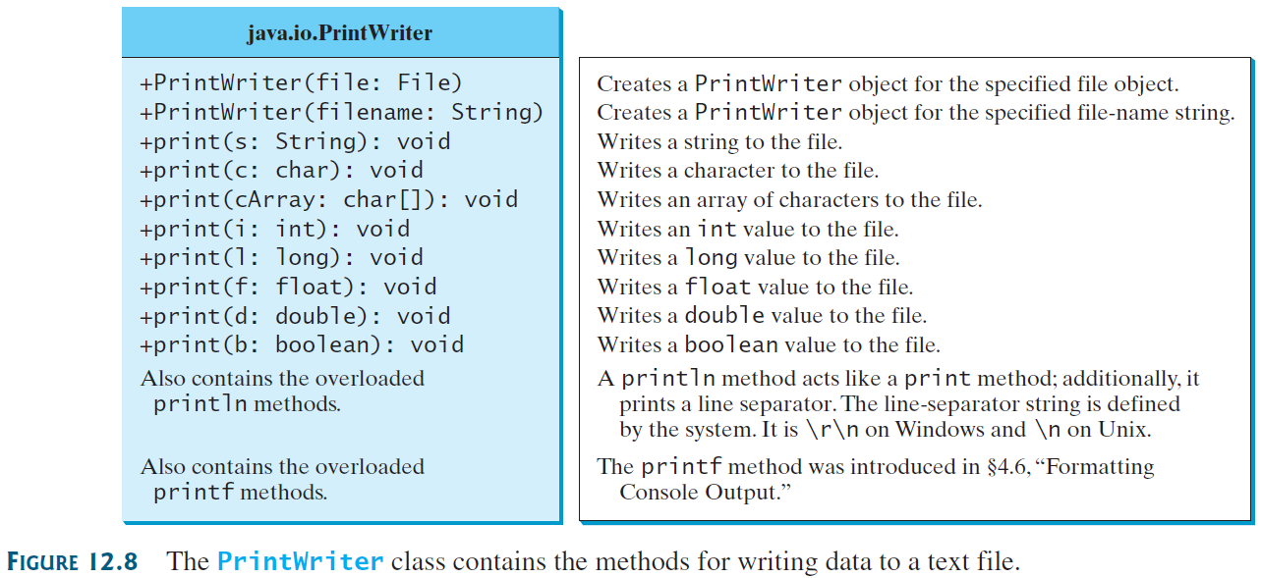
Writing Data using PrintWriter class

Slide 12
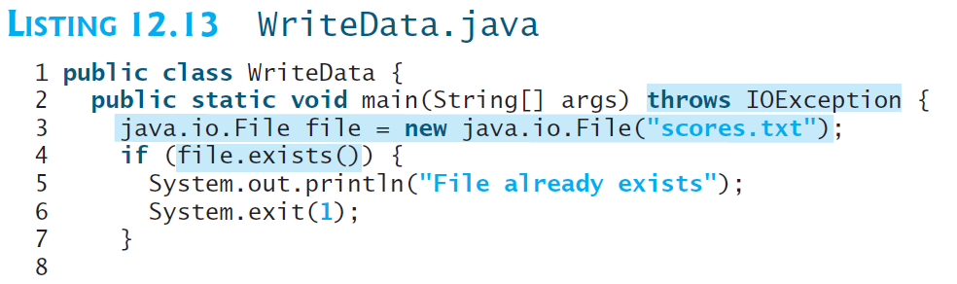
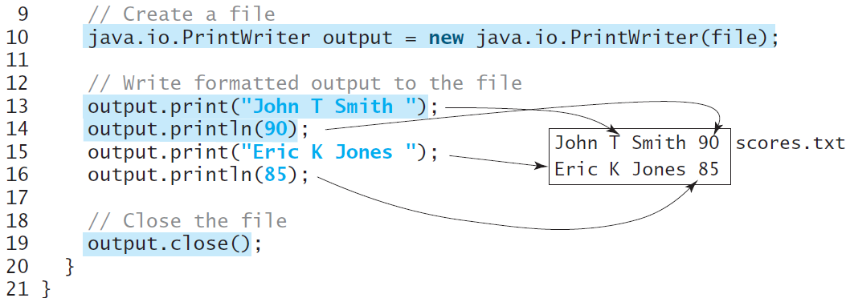
Writing Data using PrintWriter class
Lines 4–7 check whether the file scores.txt exists. If so, exit the program (line 6).
Invoking the constructor of PrintWriter will create a new file if the file does not exist. If the file already exists, the current content in the file will be overwritten without verifying with the user.
The close() method must be used to close the file (line 19). If this method is not invoked, the data may not be saved properly in the file.
Lines 4–7 check whether the file scores.txt exists. If so, exit the program (line 6).
Invoking the constructor of PrintWriter will create a new file if the file does not exist. If the file already exists, the current content in the file will be overwritten without verifying with the user.
The close() method must be used to close the file (line 19). If this method is not invoked, the data may not be saved properly in the file.

Slide 13
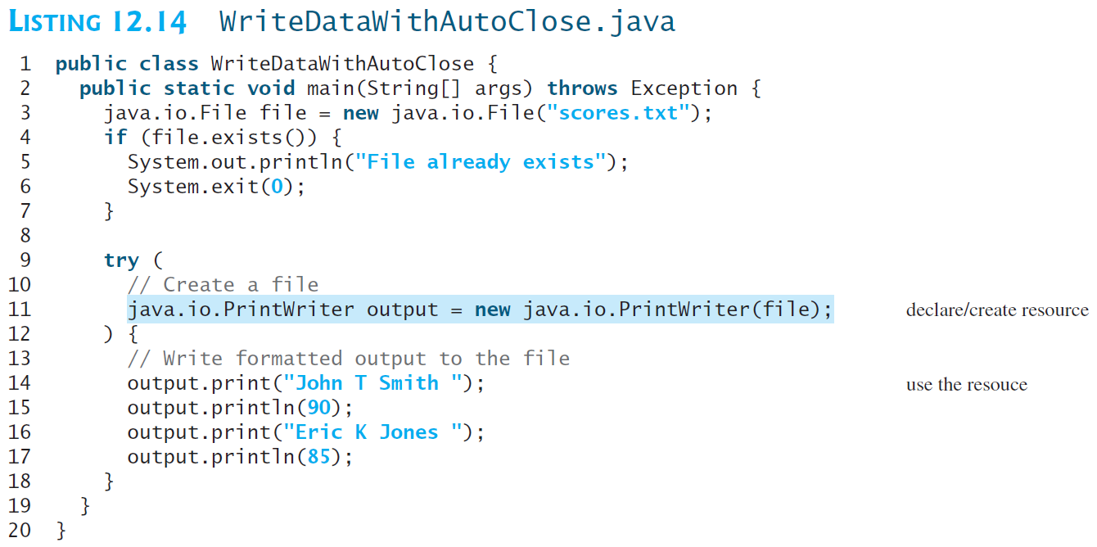
Closing Resources Automatically using try-with-resources

Slide 14
Closing Resources Automatically using try-with-resources
A resource is declared and created followed by the keyword try.
Note that the resources are enclosed in the parentheses (lines 9–12).
The resources must be a subtype of AutoCloseable interface, such as a PrinterWriter that has the close() method.
A resource must be declared and created in the same statement (i.e., with the try parenthesis).
Multiple resources can be declared and created inside the parentheses.
The statements in the block (lines 12–18) immediately following the resource declaration use the resource.
After the block is finished, the resource’s close() method is automatically invoked to close the resource.
Using try-with-resources can not only avoid errors but also make the code simpler.

Slide 15
Reading Data using Scanner class
The java.util.Scanner class is used to read strings and primitive values from the console.
A Scanner breaks its input into tokens delimited by whitespace characters.
To read from the keyboard, you create a Scanner for System.in, as follows:
Scanner input = new Scanner(System.in);
To read from a file, create a Scanner for a file, as follows:
Scanner input = new Scanner(new File(filename));

Slide 16
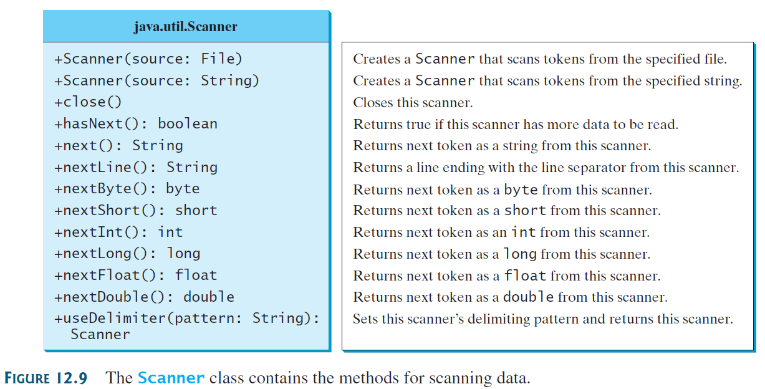
Reading Data using Scanner class

Slide 17
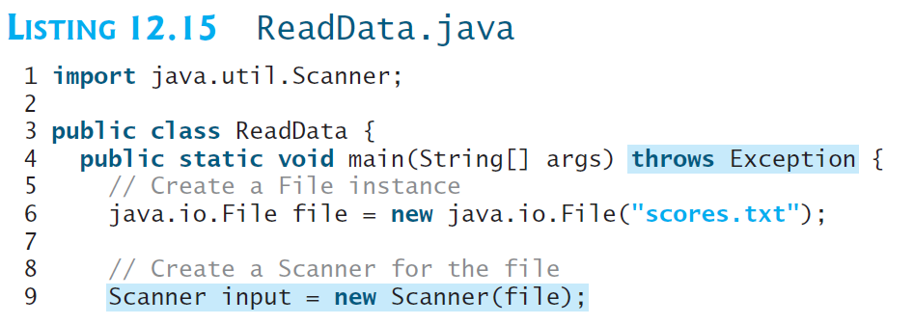
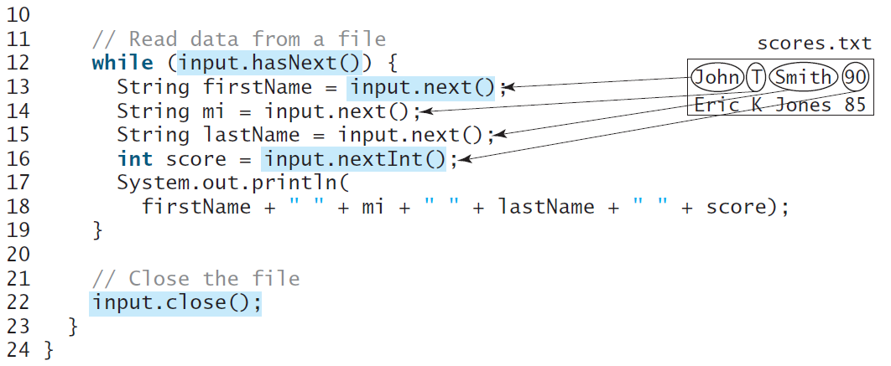
Reading Data using Scanner class
Invoking the constructor new Scanner(File) may throw an I/O exception, so the main method declares throws Exception in line 4.
Each iteration in the while loop reads the first name, middle initial, last name, and score from the text file (lines 12–19).
It is not necessary to close the input file (line 22), but it is a good practice to do so to release
the resources occupied by the file. You can rewrite this program using the try-with-resources syntax.

Slide 18
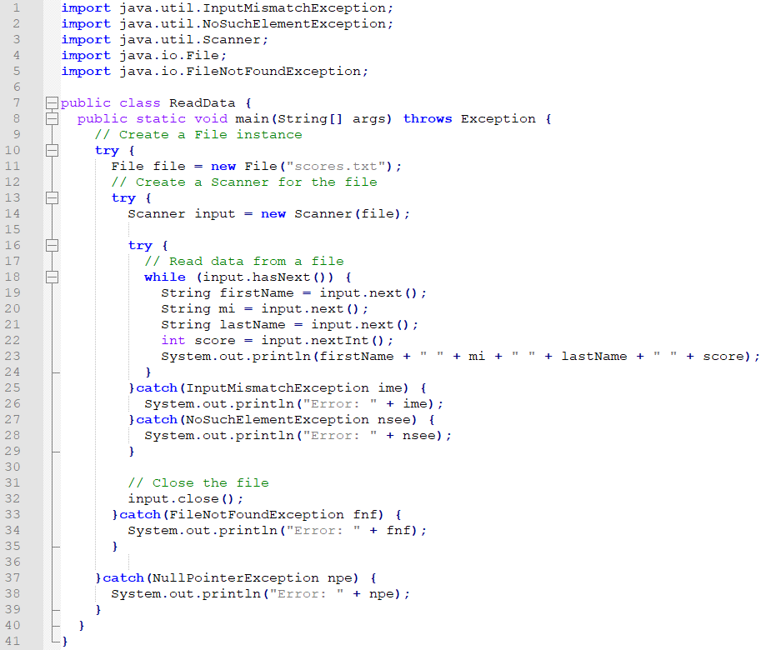
Reading Data using Scanner class: Adding try-catch

